Slide 1
FINGERPRINT RECOGNISATION SYSTEM IN THE EVM
(ELECTRONIC VOTING MACHINE)

Slide 2
What is an EVM?
India is the largest democratic country in the world. Active involvement of the public in the formation of the government is an essential aspect of a democratic government. This is confirmed by an election. Conducting elections in a populated country like India is a difficult task. It’s a test to conduct elections for collection of candidates to signify the people of the country at different levels. To overcome this problem.
An EVM (electronic voting machine) is an answer to all these complications. In the worldwide, several countries have shown their interest in learning the mechanism behind this powerful machine. It’s got a very simple interface, its tamper proof, avoids the fake voting and it has helped in receiving rid of the time consuming duty of counting.

Slide 3
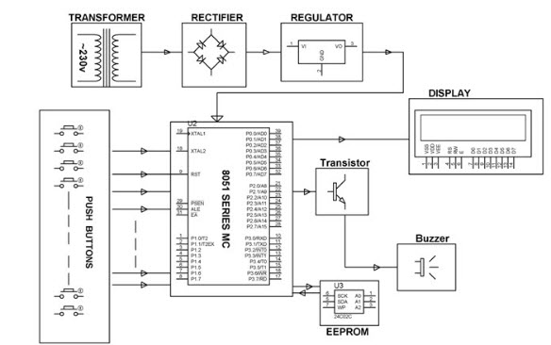
CIRCUIT DIAGRAM OF EVM

Slide 4
PROJECT OBJECTIVE?
The goal of our project is to develop a complete system for fingerprint verification through extracting and matching minutiae(which is used as identification mark for fingerprint verification). To achieve good minutiae extraction in fingerprints with varying quality, preprocessing in the form of image enhancement and binarization is first applied on finger prints before they are evaluated.The main objective of this project is to avoid the malpractise of voting i.e voting to many times during the elections which is also called as rigging.

Slide 5
WHAT’S NEW IN OUR PROJECT?
Instead of the push buttons in the EVM we are going with the capacitive scanner.
CAPACITIVE SCANNER:Another type of scanner, known as a capacitive scanner, measures your finger electrically. When your finger rests on a surface, the ridges in your fingerprints touch the surface while the hollows between the ridges stand slightly clear of it. In other words, there are varying distances between each part of your finger and the surface below. A capacitive scanner builds up a picture of your fingerprint by measuring these distances. Scanners like this are a bit like the touchscreens on things like iPhones and iPads.

Slide 6
What is Arduino Uno?
Arduino is a single-board microcontroller meant to make the application more accessible which are interactive objects and its surroundings. The hardware features with an open-source hardware board designed around an 8-bit Atmel AVR microcontroller or a 32-bit Atmel ARM. Current models consists a USB interface, 6 analog input pins and 14 digital I/O pins that allows the user to attach various extension boards.

Slide 7
The Arduino Uno board is a microcontroller based on the ATmega328. It has 14 digital input/output pins in which 6 can be used as PWM outputs, a 16 MHz ceramic resonator, an ICSP header, a USB connection, 6 analog inputs, a power jack and a reset button. This contains all the required support needed for microcontroller. In order to get started, they are simply connected to a computer with a USB cable or with a AC-to-DC adapter or battery. Arduino Uno Board varies from all other boards and they will not use the FTDI USB-to-serial driver chip in them. It is featured by the Atmega16U2 (Atmega8U2 up to version R2) programmed as a USB-to-serial converter.

Slide 8
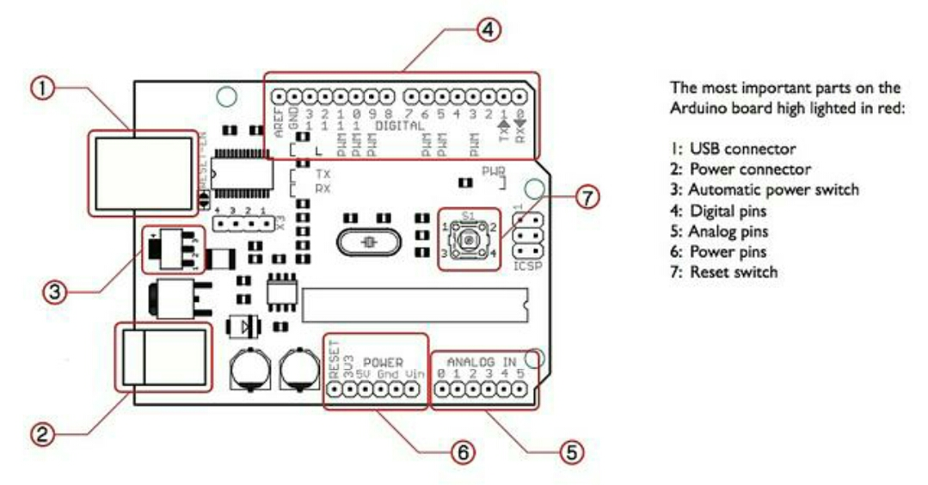
Arduino Uno

Slide 9
Conclusion
This project can be used for voting since it overcome all the draw of ordinary voting machine also provide additional security.Its main advantage is that since fingerprints of every person is unique and hence this system completely reduces the chance of invalid votes.The system can be manufactured simply as well as cheap.

